Slide 1
How I came to say: "no thanks, I actually prefer command line"
Janina Fuss
INF-BIO5151/9121
15.10.15

Slide 2

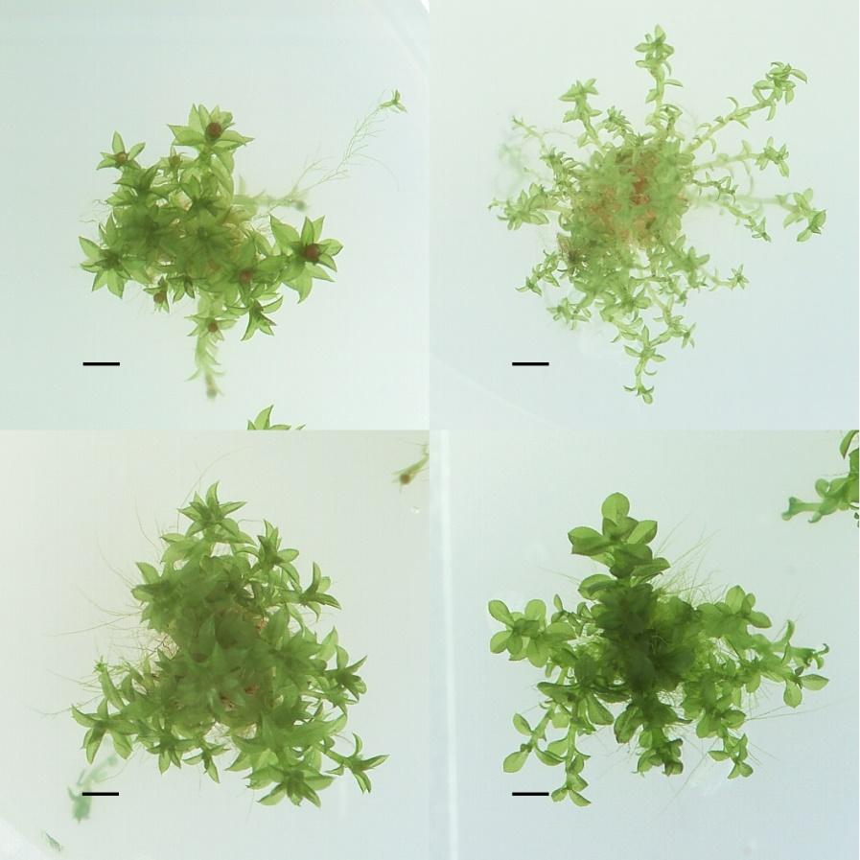
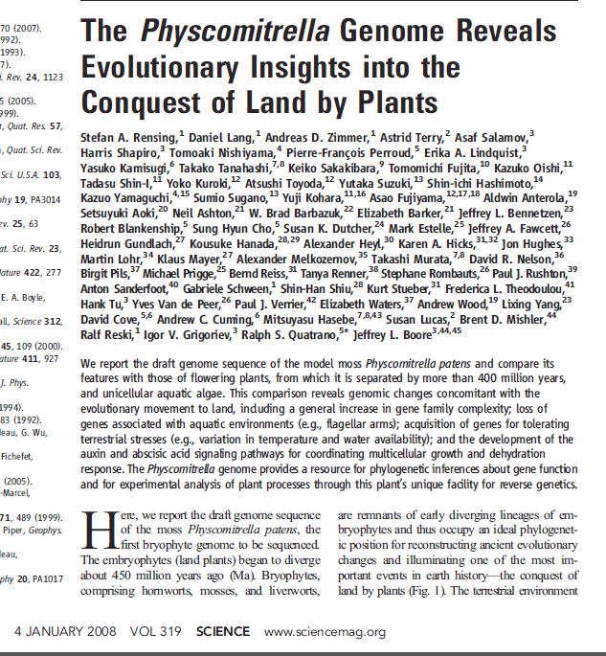
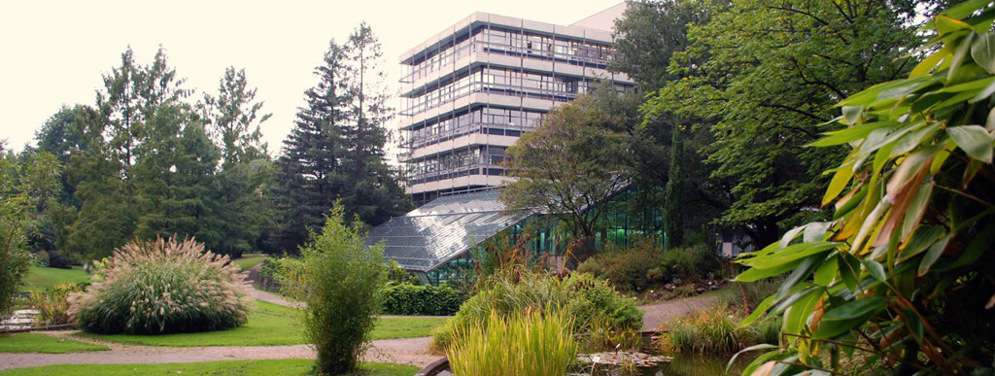
The beginning... (2006-2007)

Slide 3
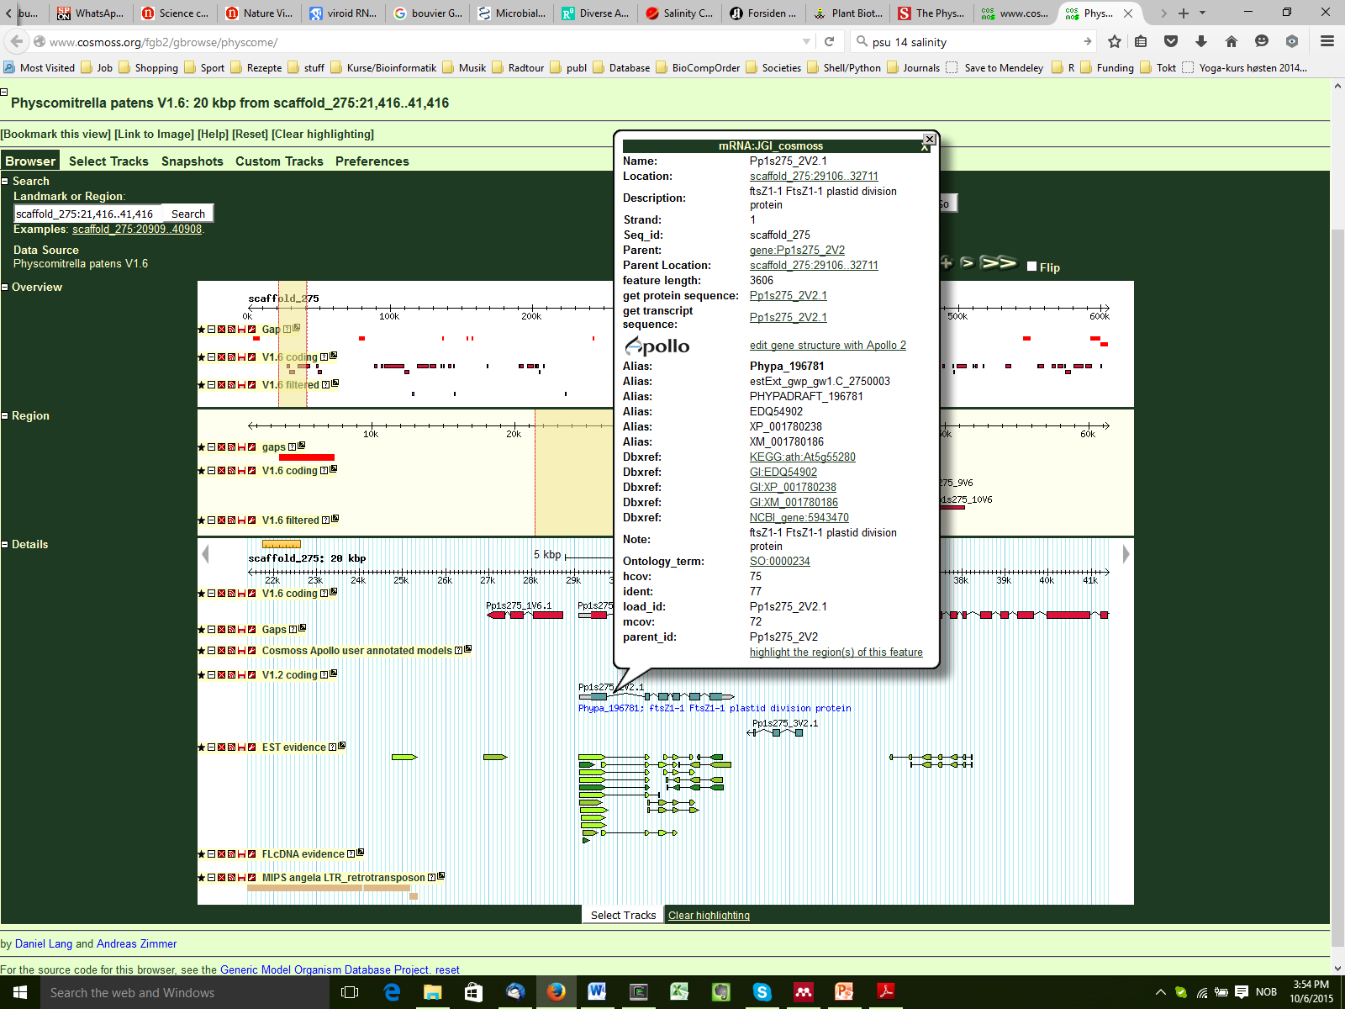
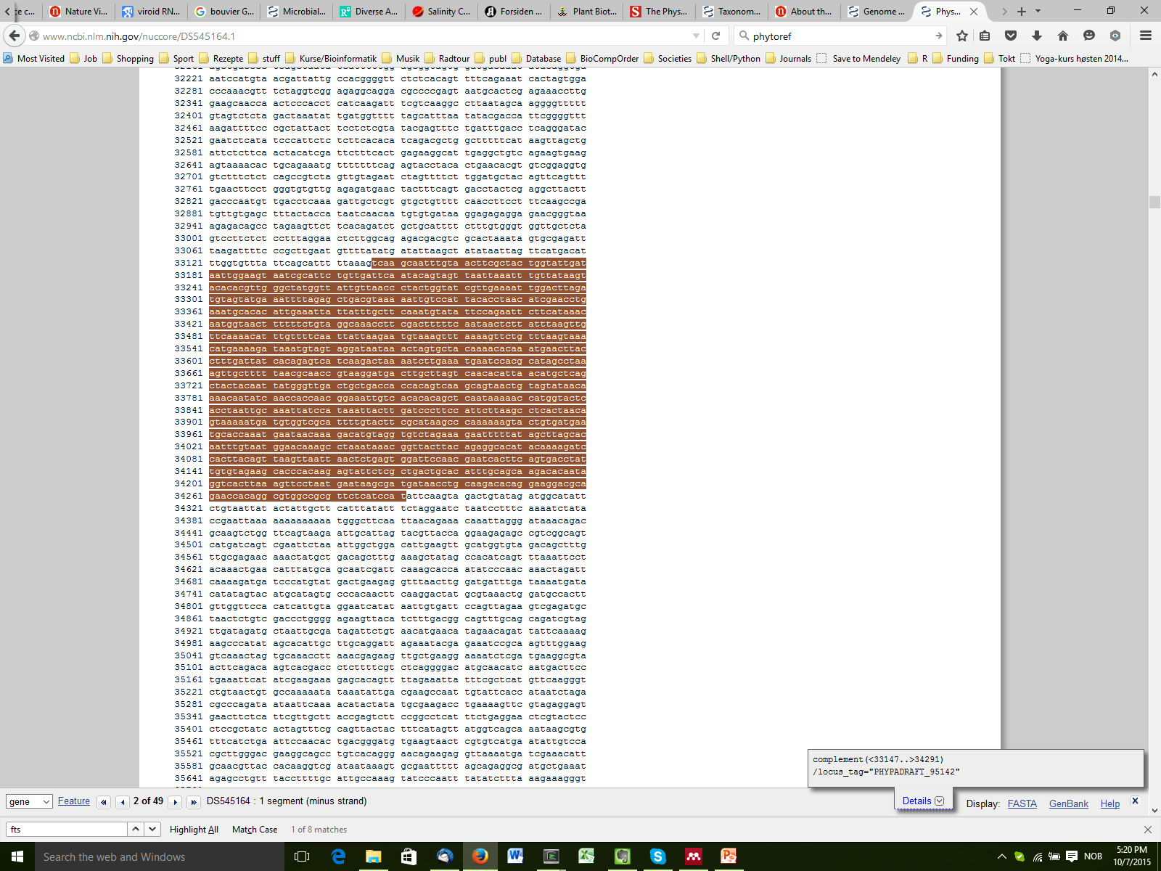
5’ UTR??????

Slide 4
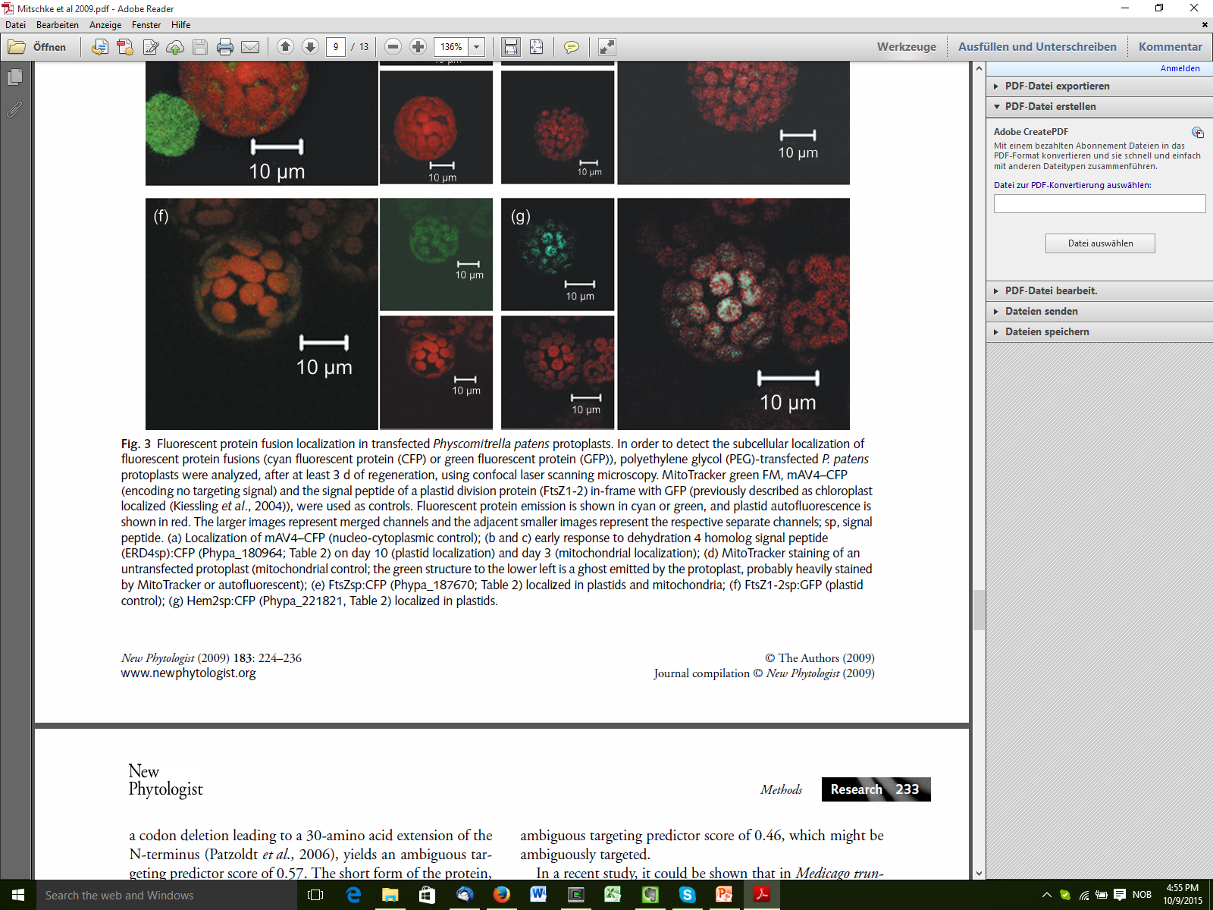
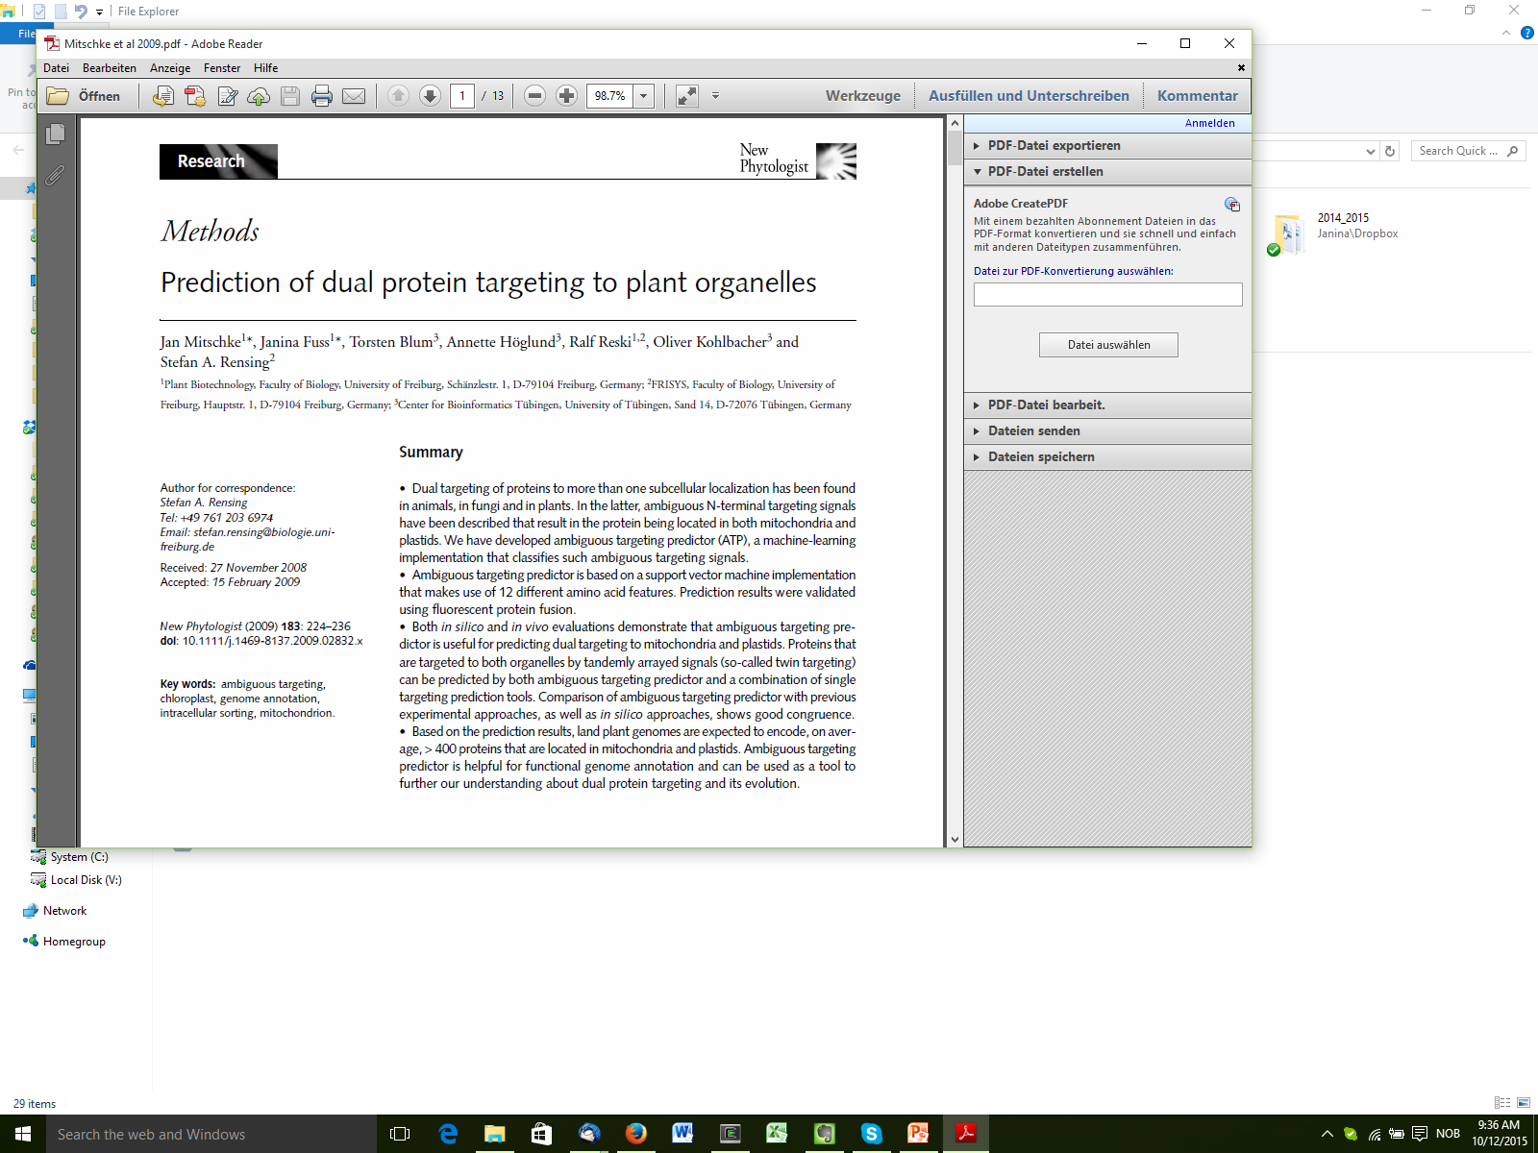
“Analysis of Dual Targeting in Plants”

Slide 5
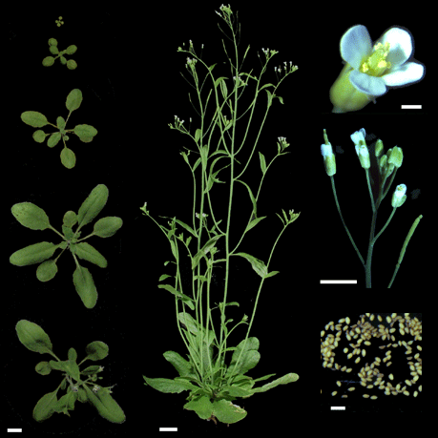
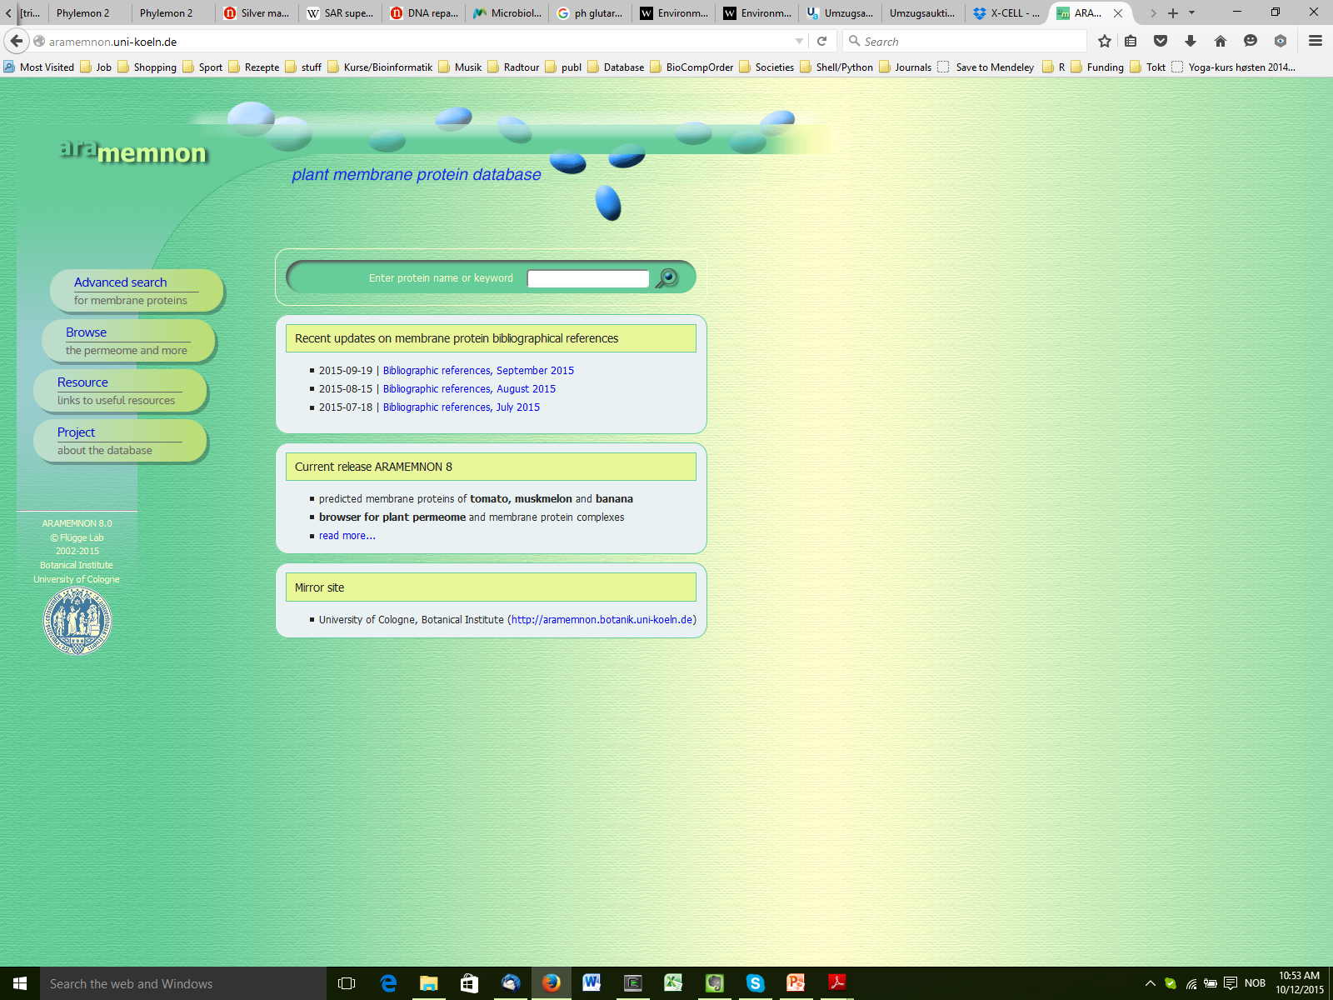
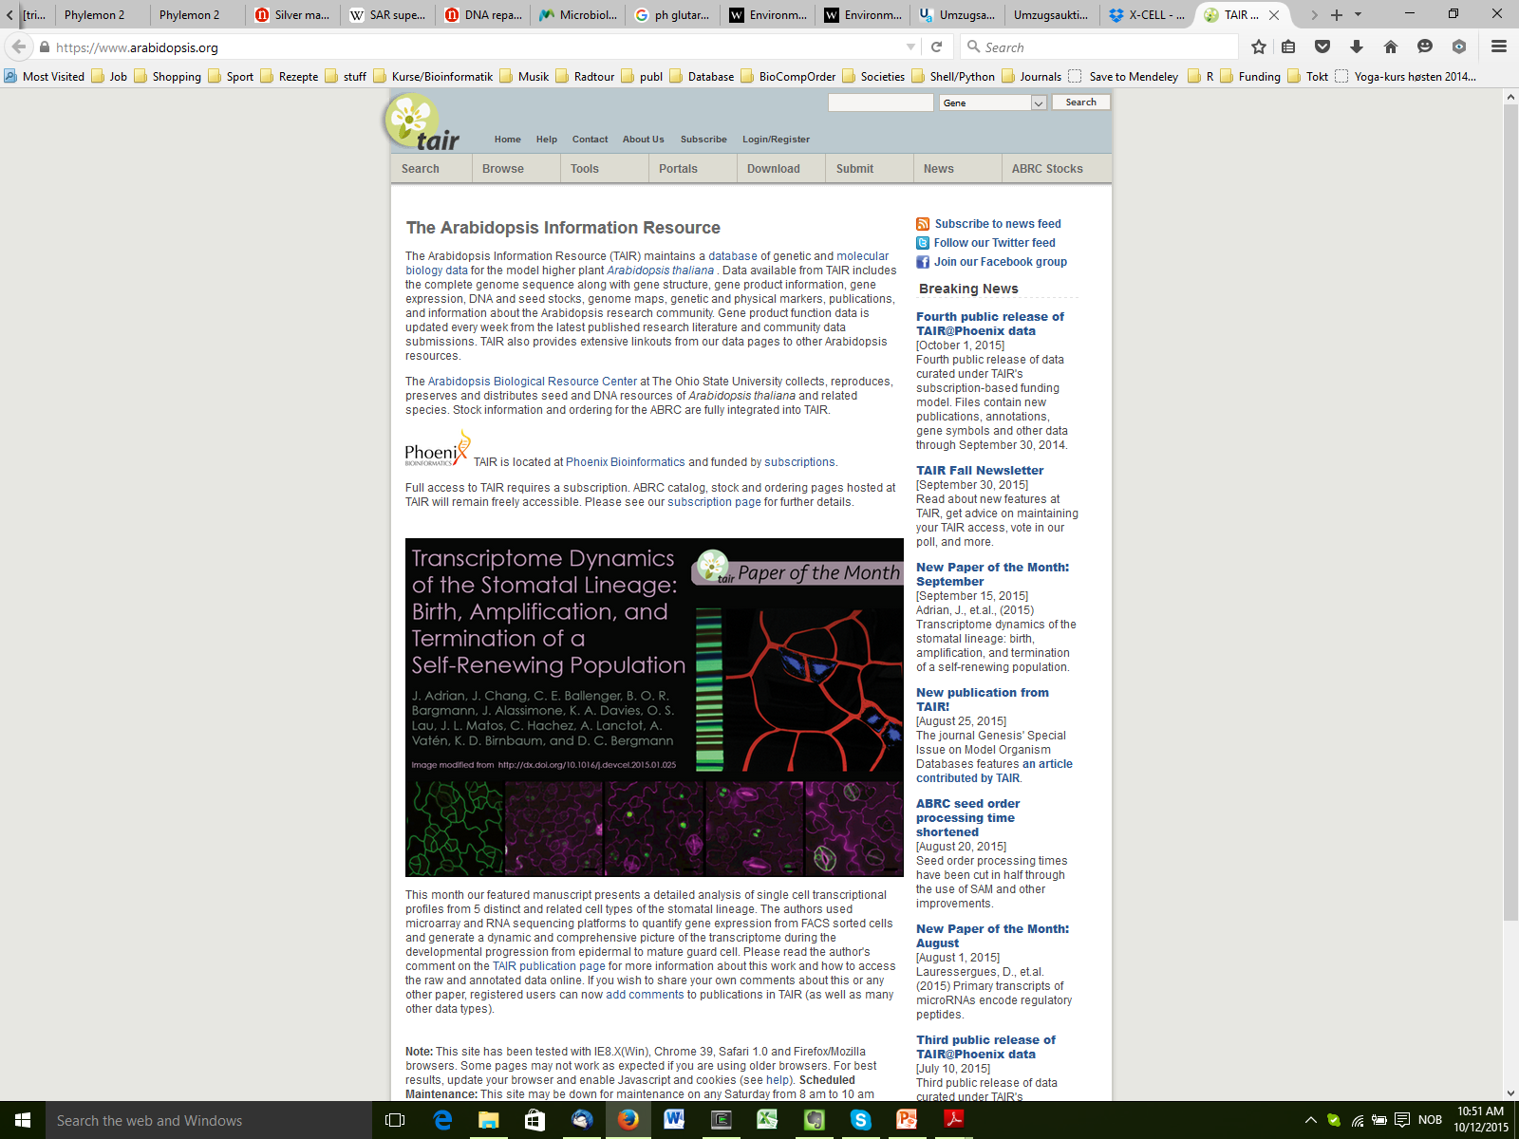
The next step... (2008-2012)
Sequenced 2000

Slide 6

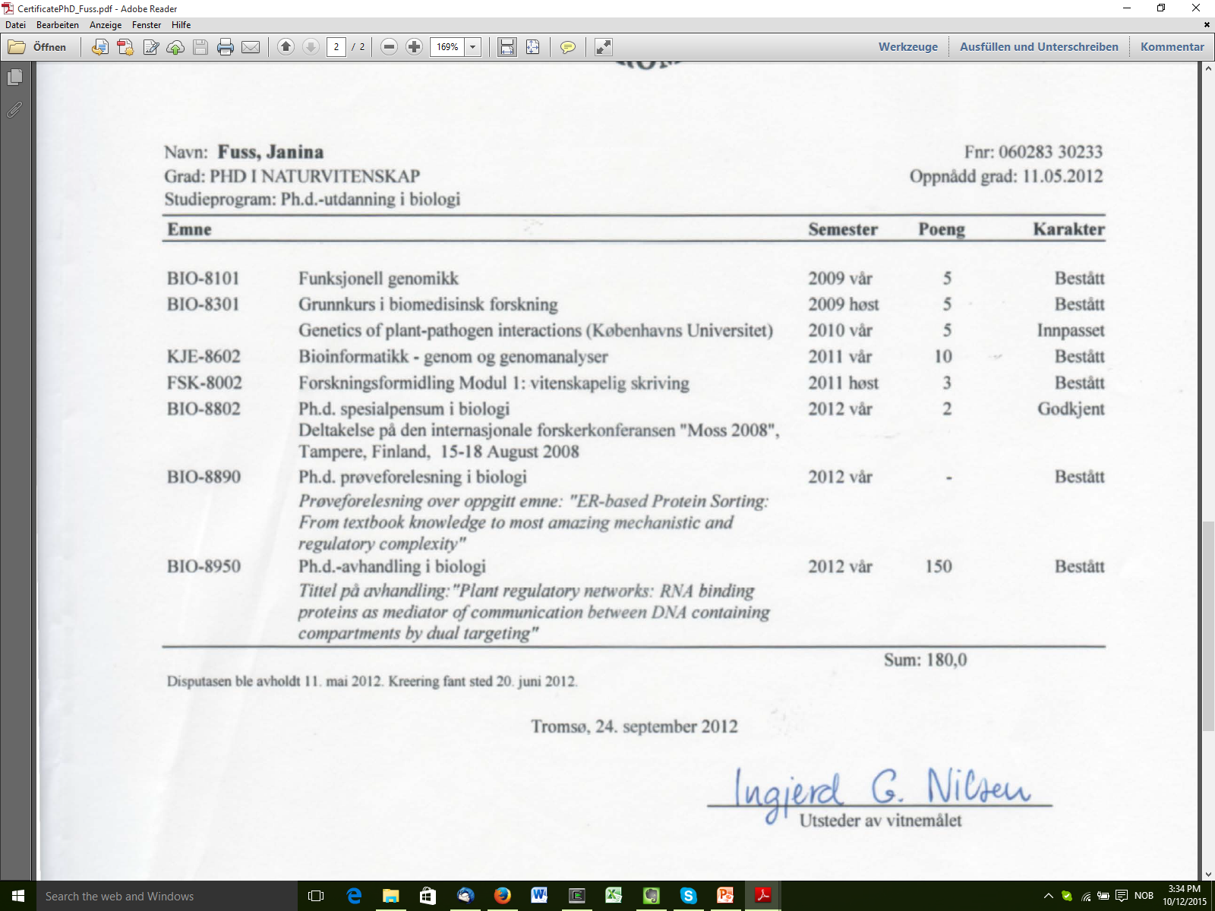
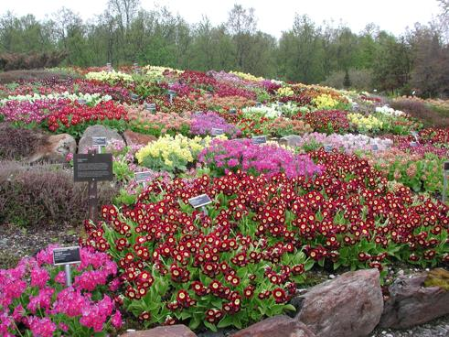
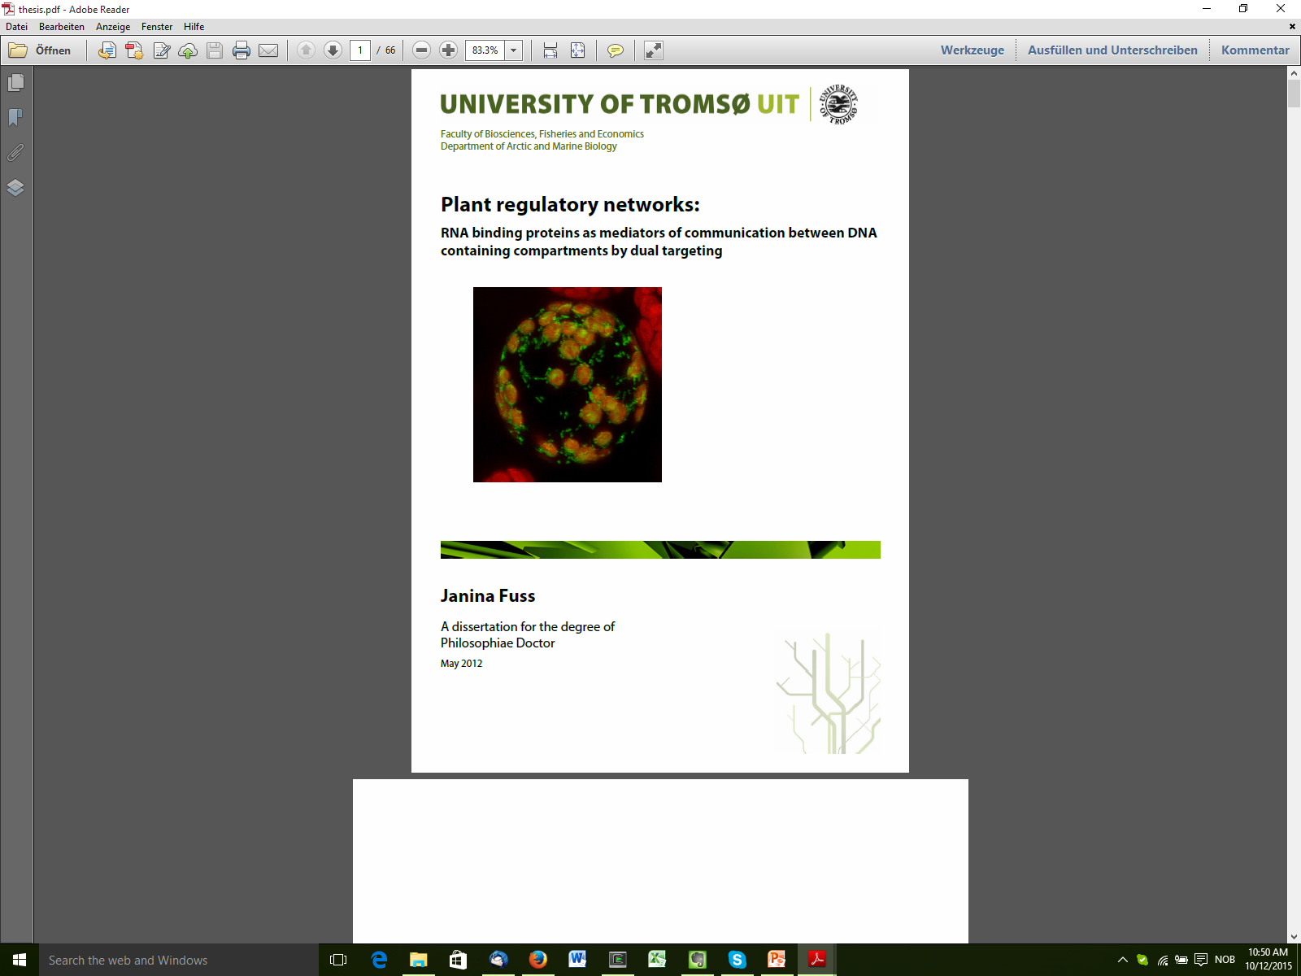
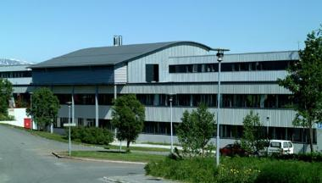
We can’t do RNAseq because we can’t analyse it ourselves!

Slide 7
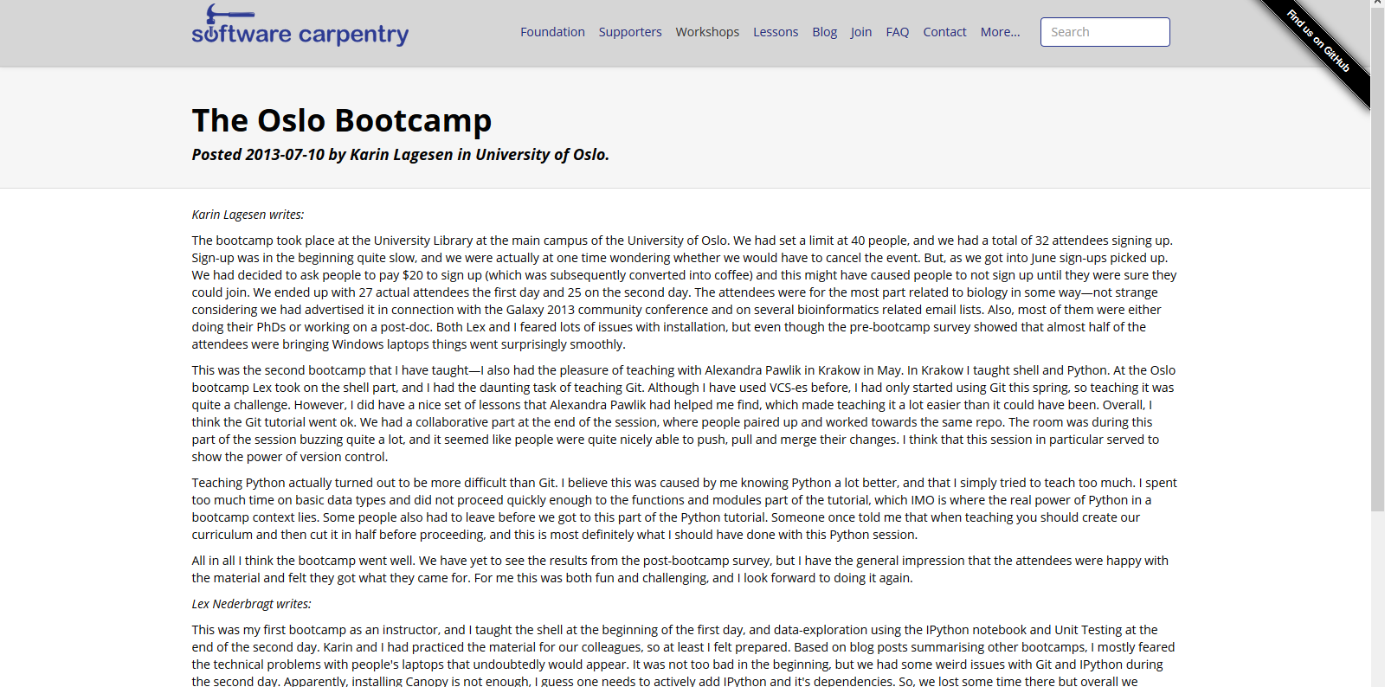
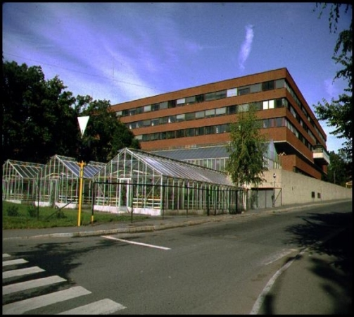
2013 - now

Slide 8
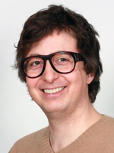
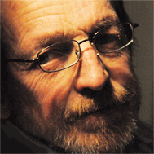
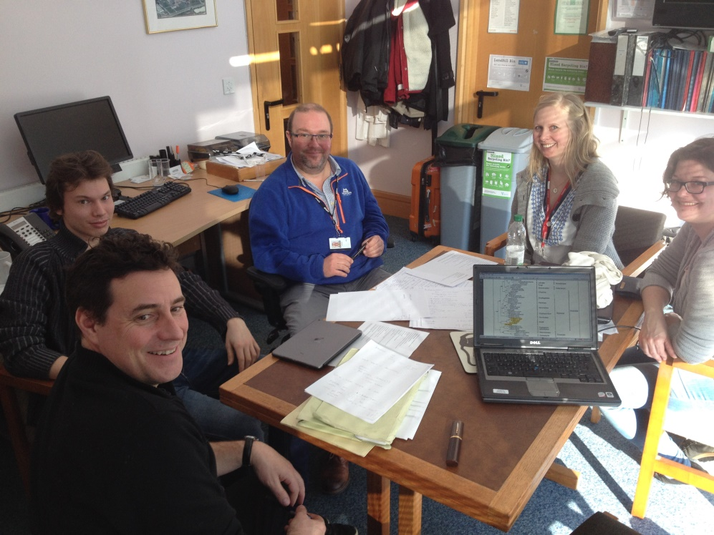
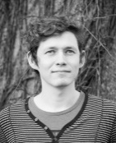

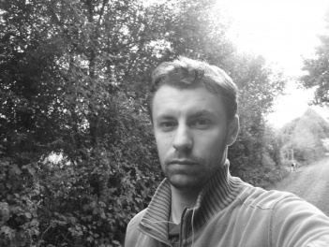
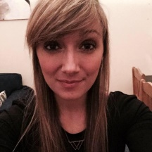
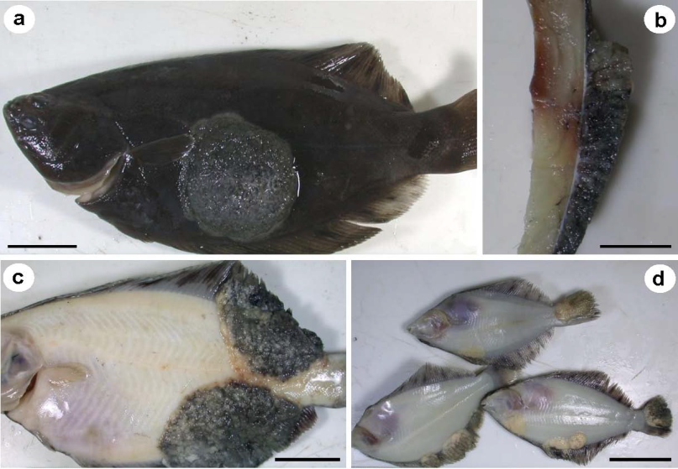
The X-cell project...
Amplicon sequencing
(Meta)genome analysis
Phylogenomics
Statistical analyses in R
...because we want to know more about this:

Slide 9
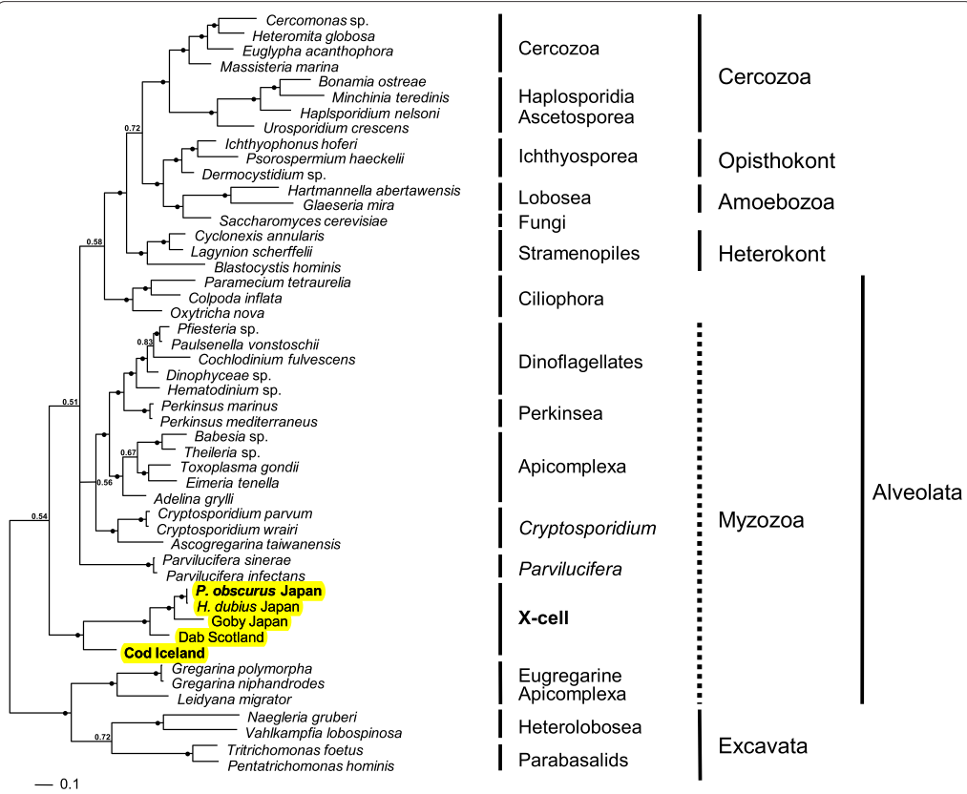

Slide 10
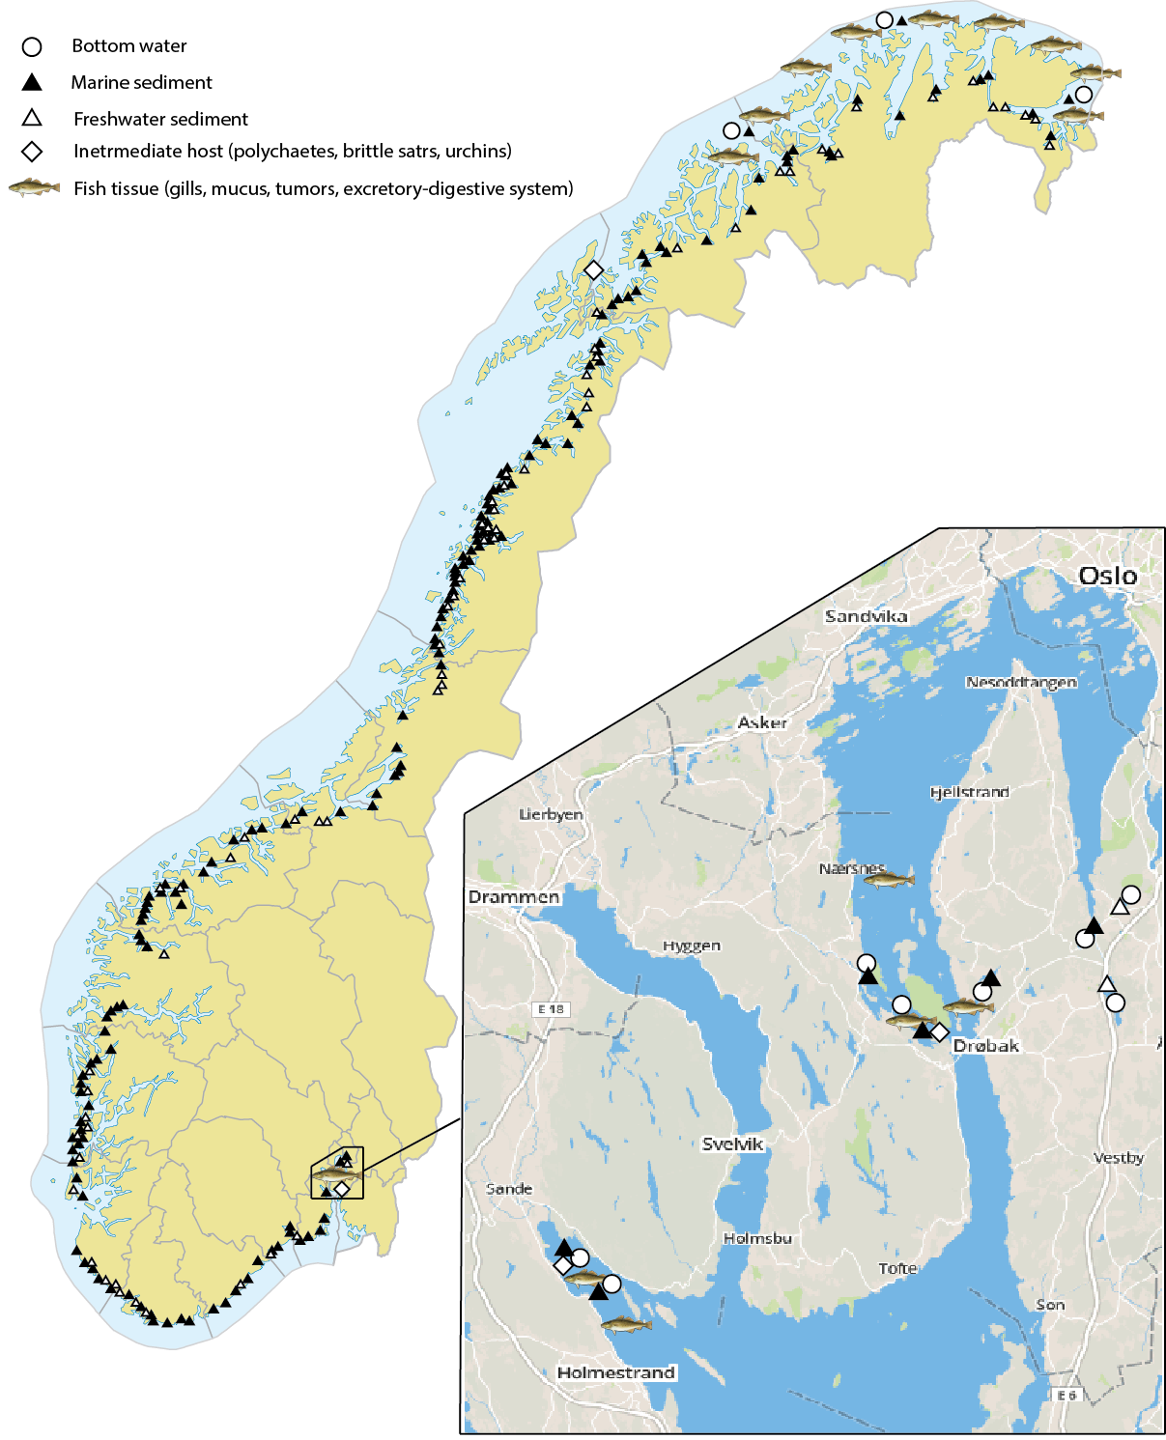
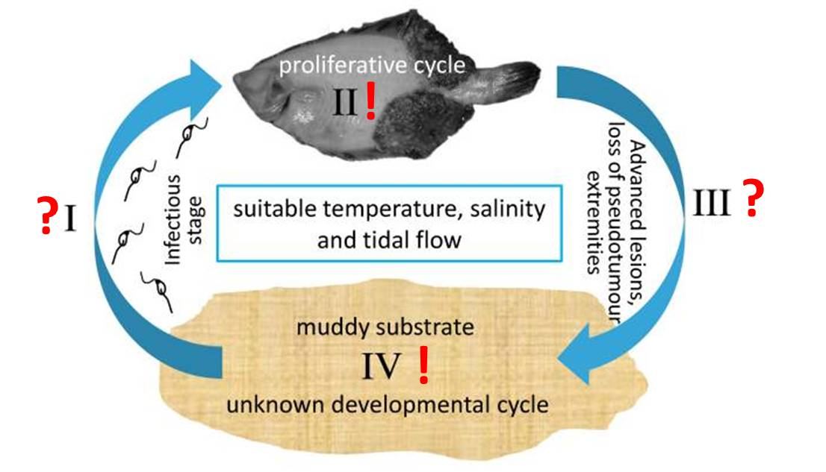
Amplicon sequencing

Slide 11
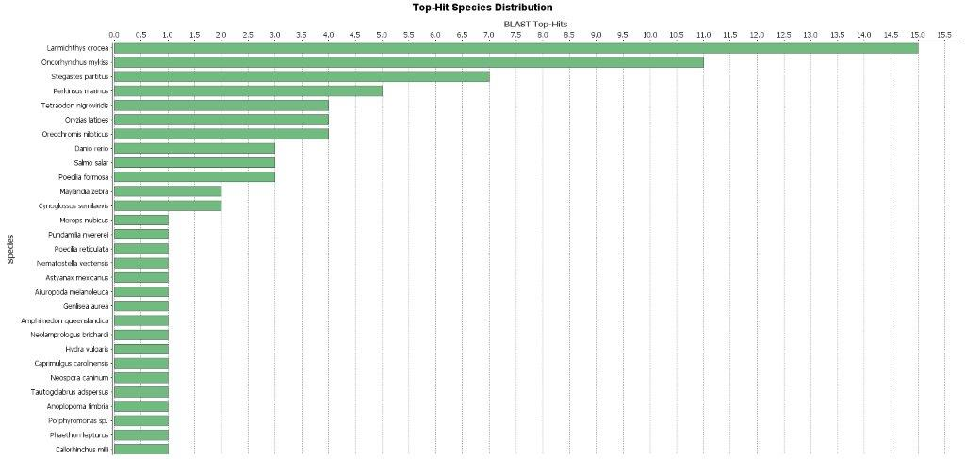



Slide 12
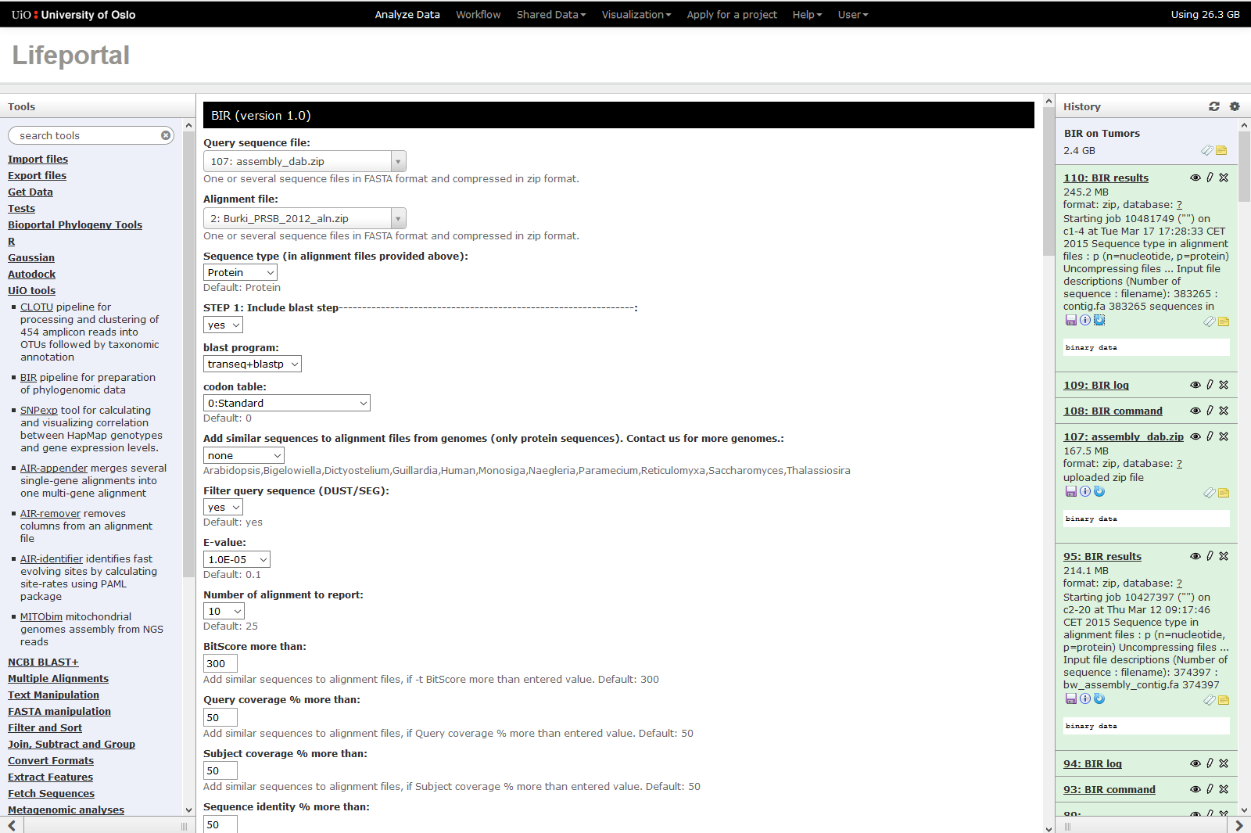
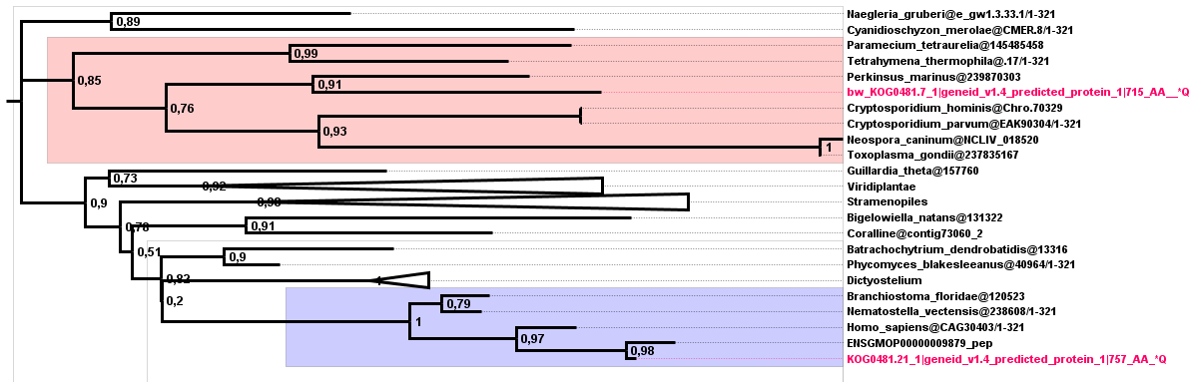

Slide 13
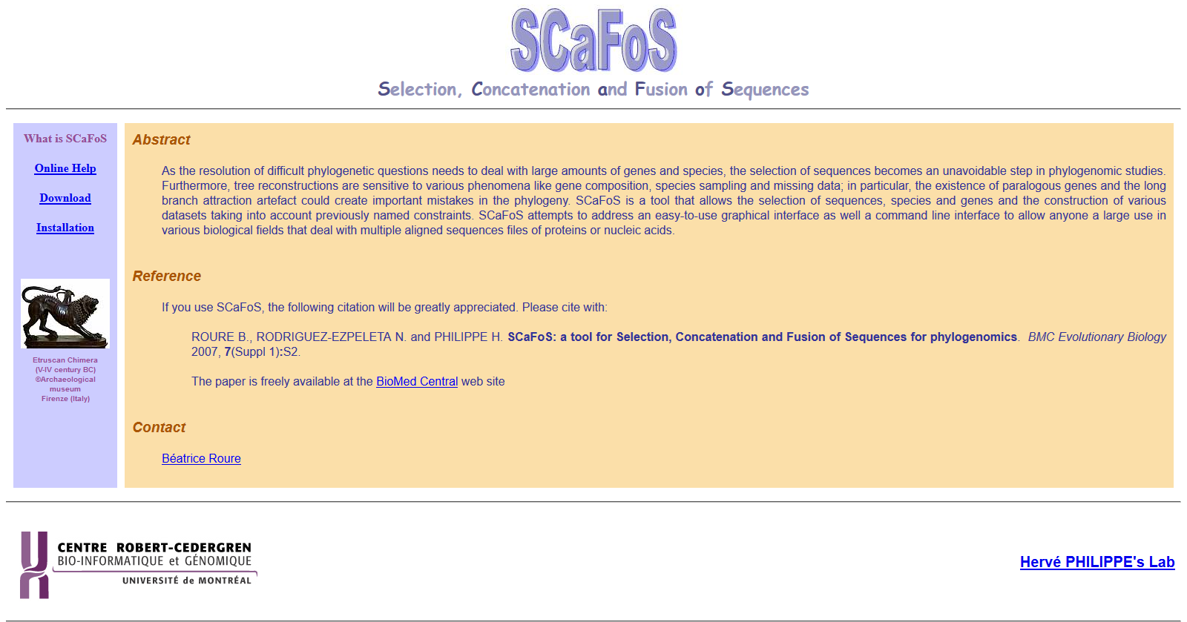
no thanks, I actually prefer command line!

Slide 14
How I got there:
Practice, practice and some more practice!
Use test datasets
Make a trial directory
Play with settings!

Slide 15
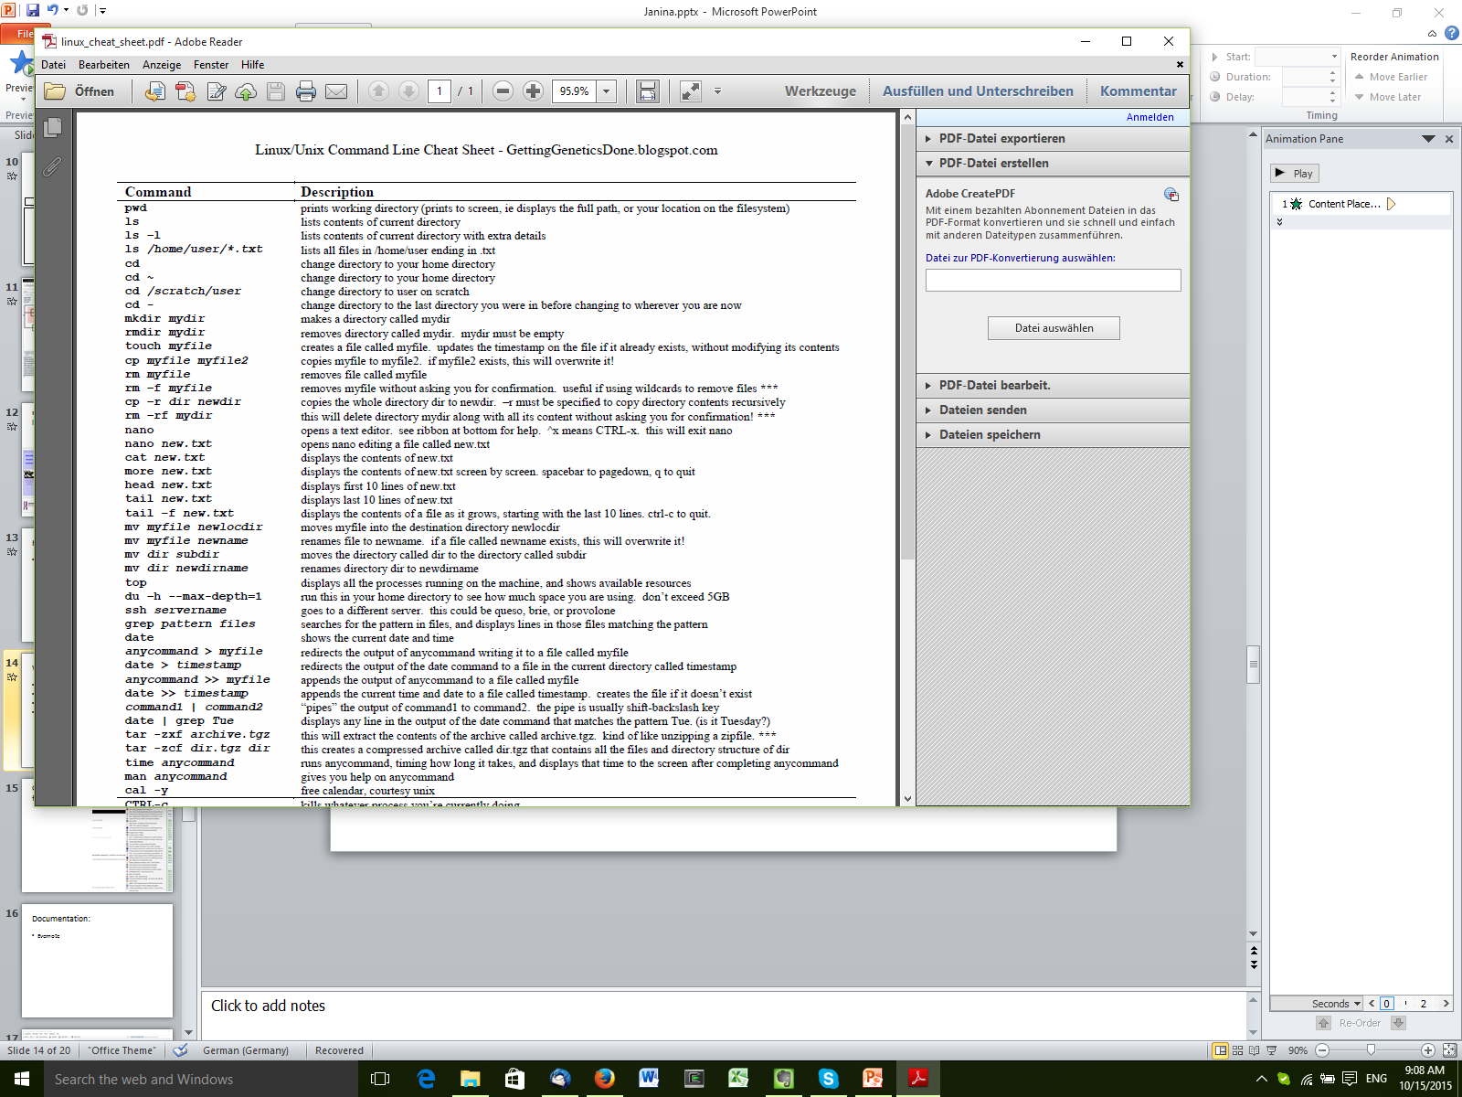
What helped to get there:
Cheat sheet
Practice
Google
Documentation!
Scripts!

Slide 16
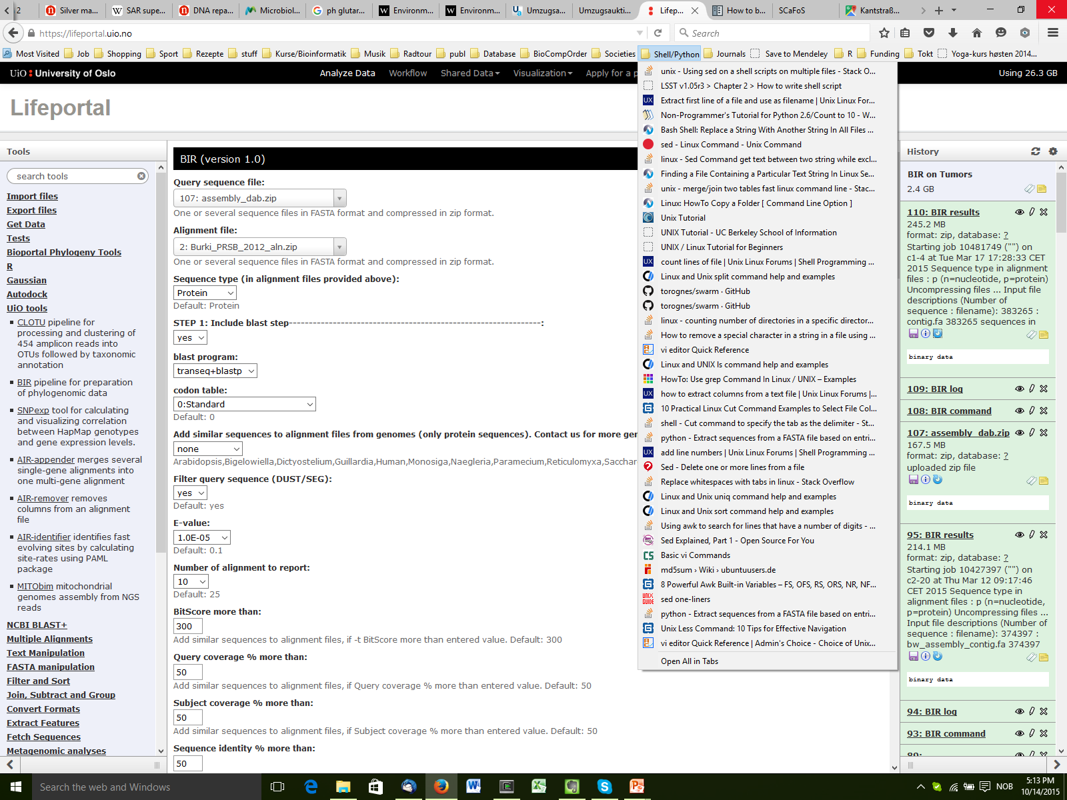
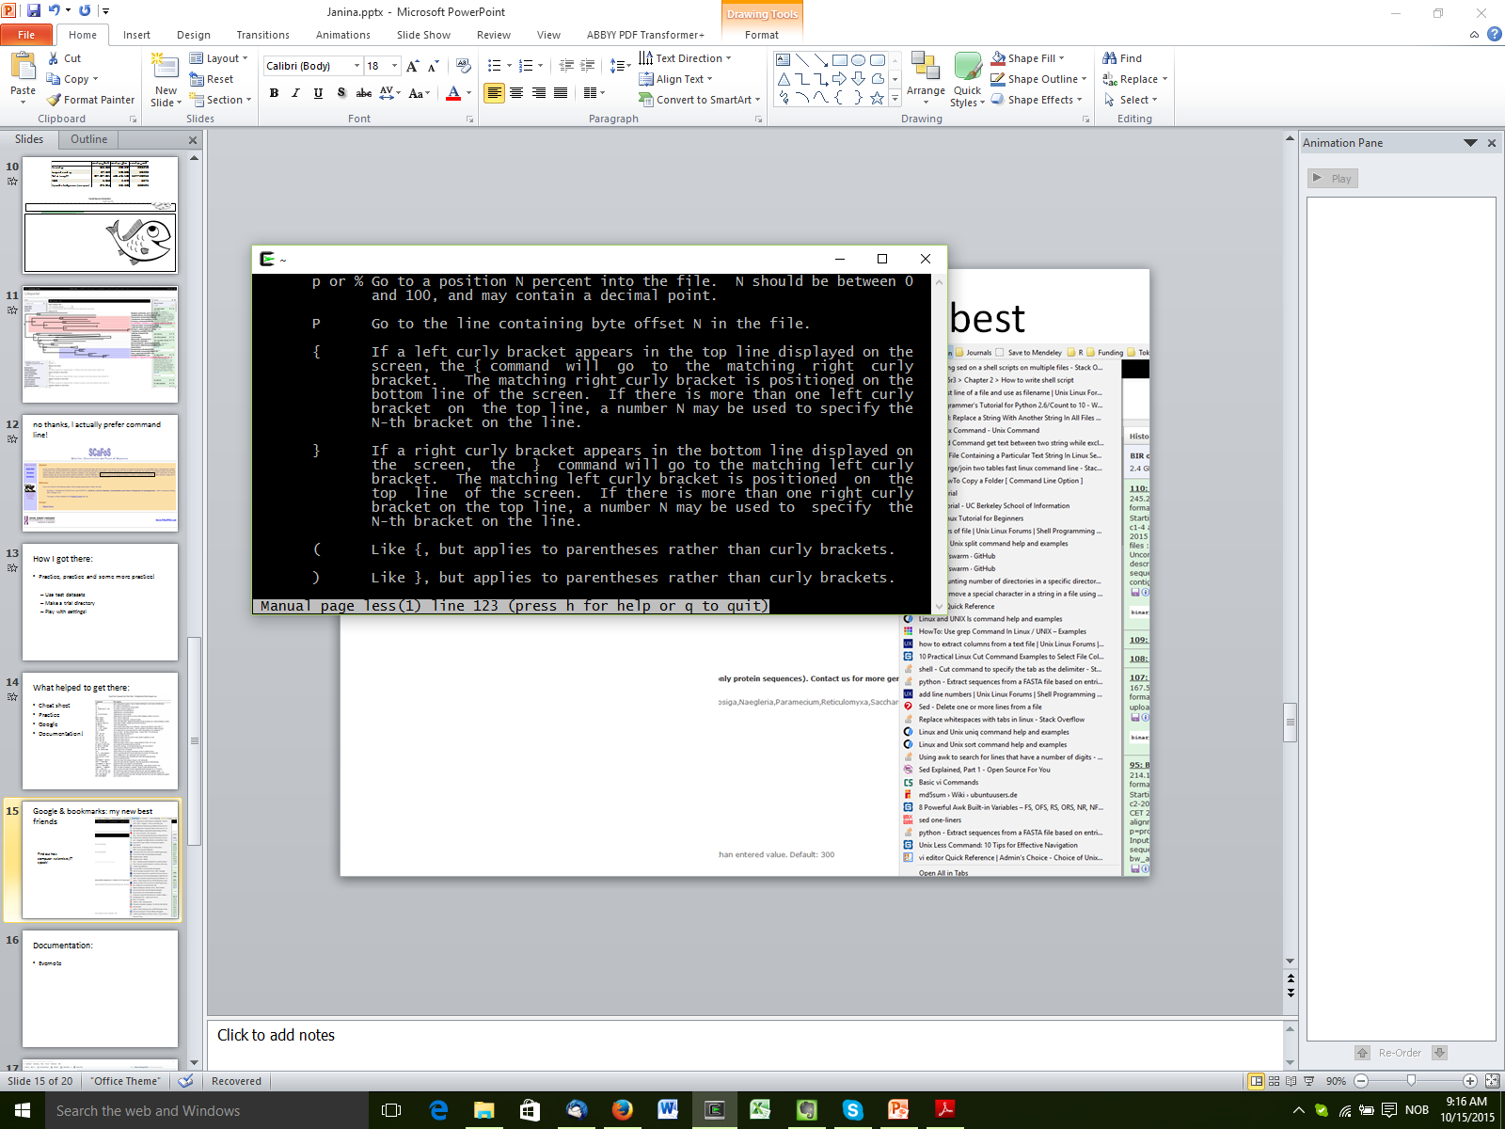
Google & bookmarks: my new best friends
Find out how computer scientists/IT speak!

Slide 17
Documentation:
Evernote/OneNote
(or anything else that you feel comfortable with)

Slide 18
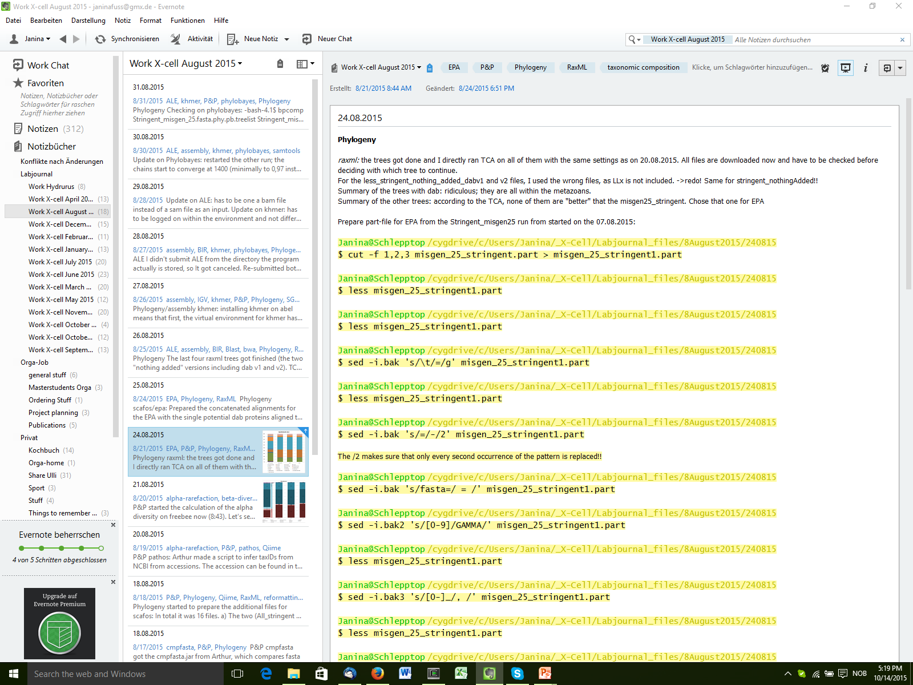

Slide 19
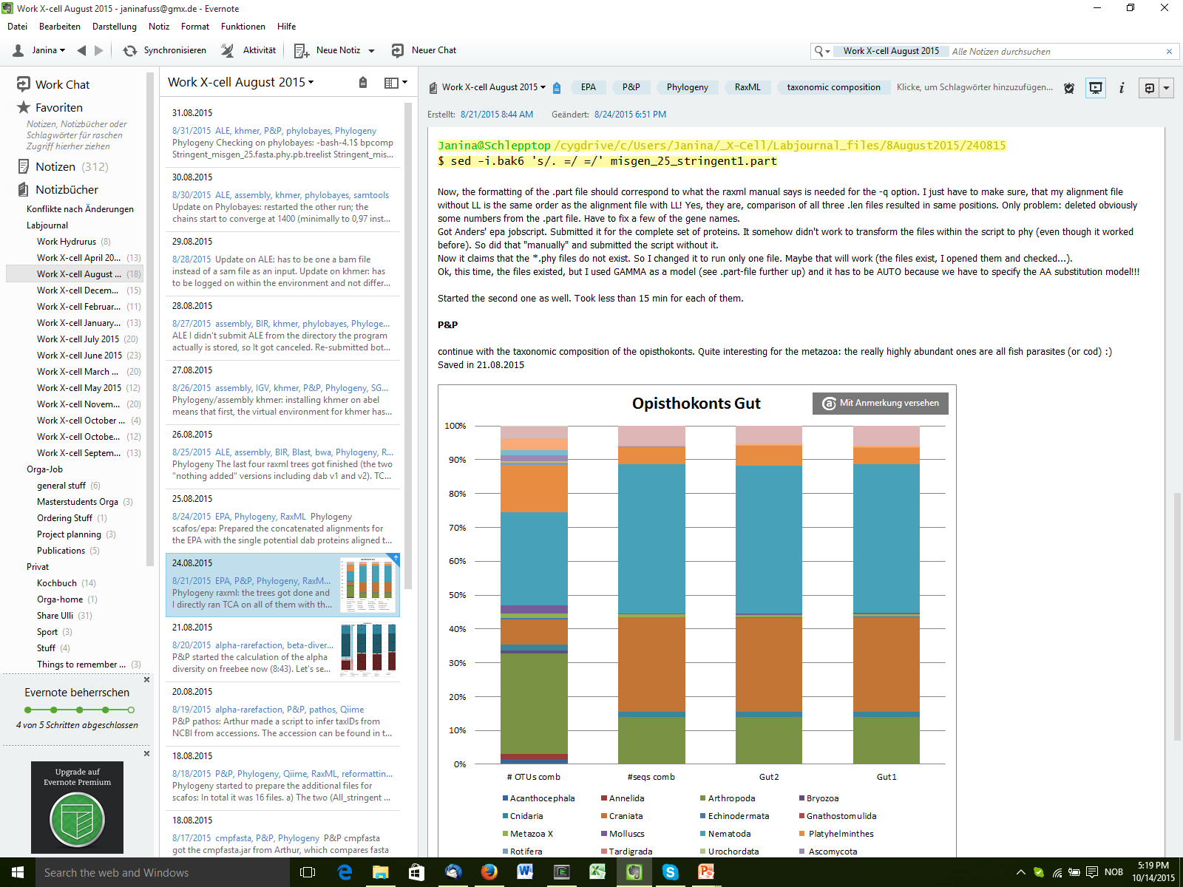

Slide 20
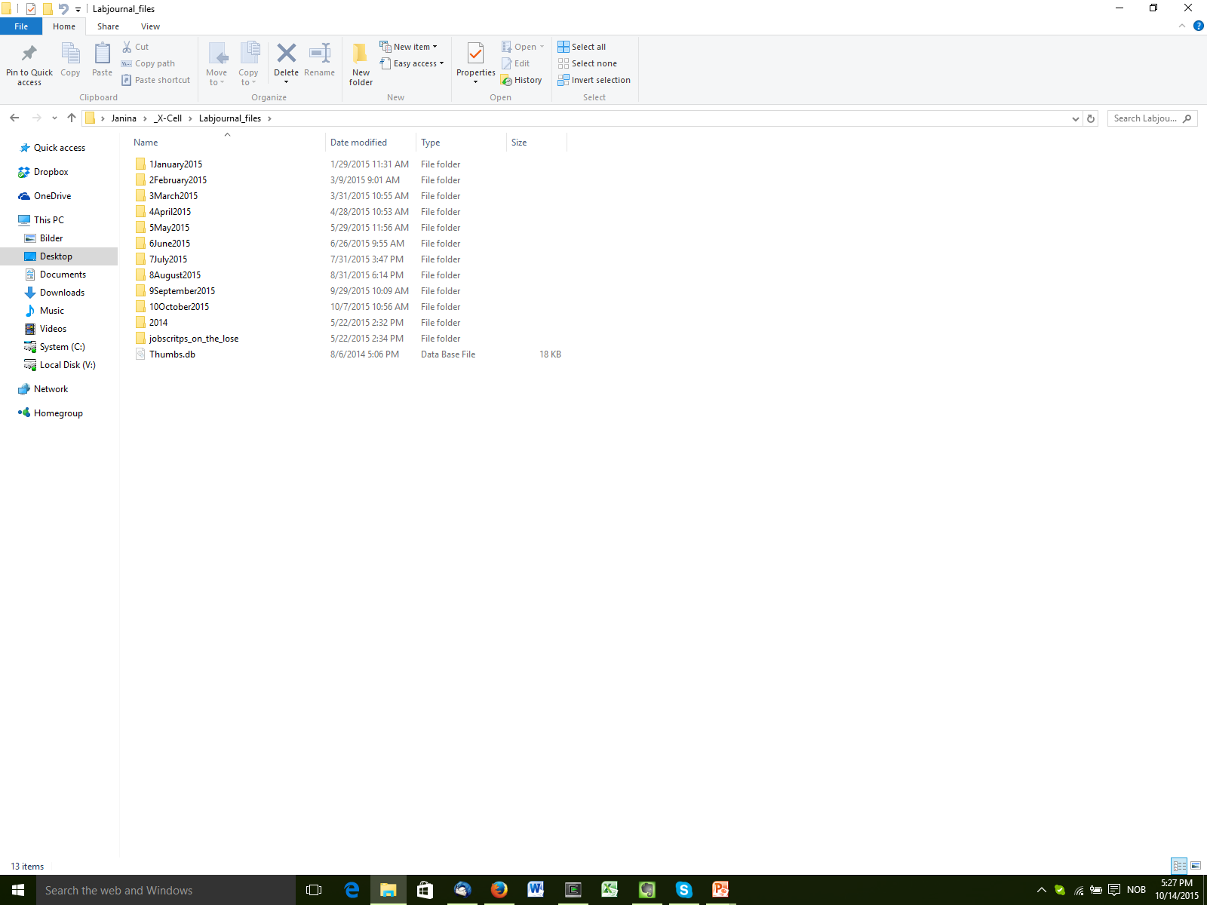
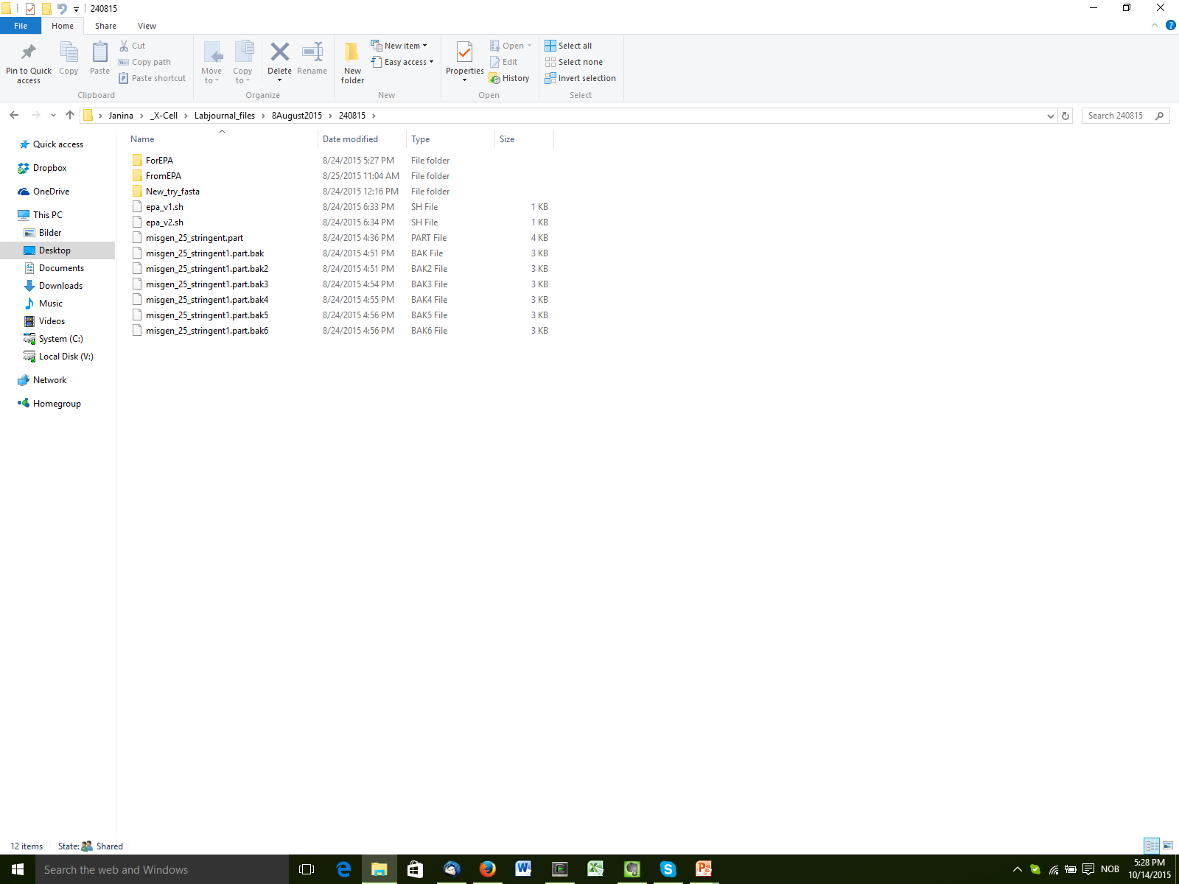
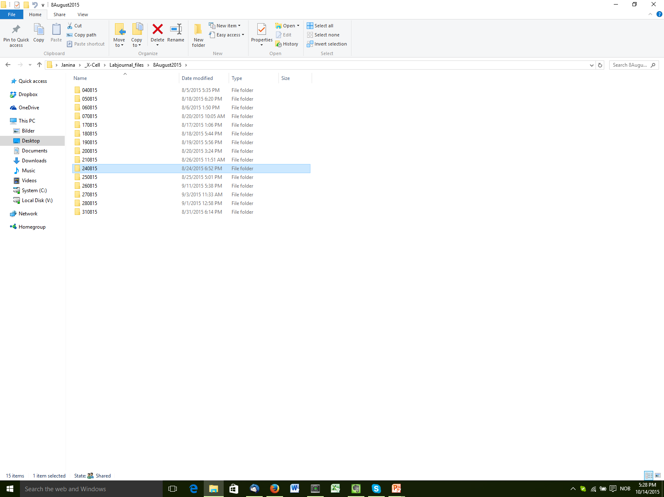
Documentation:
Evernote
Filesystem

Slide 21
Few more things
Probably your colleagues know stuff!
Write SOPs also for bioinformatics
Have a close look at error messages!
python: can't open file '/usit/abel/u1/janinaf/nobackup/khmer_env/bin/normalize-by- median.py': [Errno 2] No such file or directory

Slide 22
Some things to check:
Input file formatting!!!!!!!!!!!!!!!!!
Whitespaces!!!!!!!!!!!!!!!!!
Windows to Linux incompatibilities (line breaks!)

Slide 23

Happy testing

